Slide 1
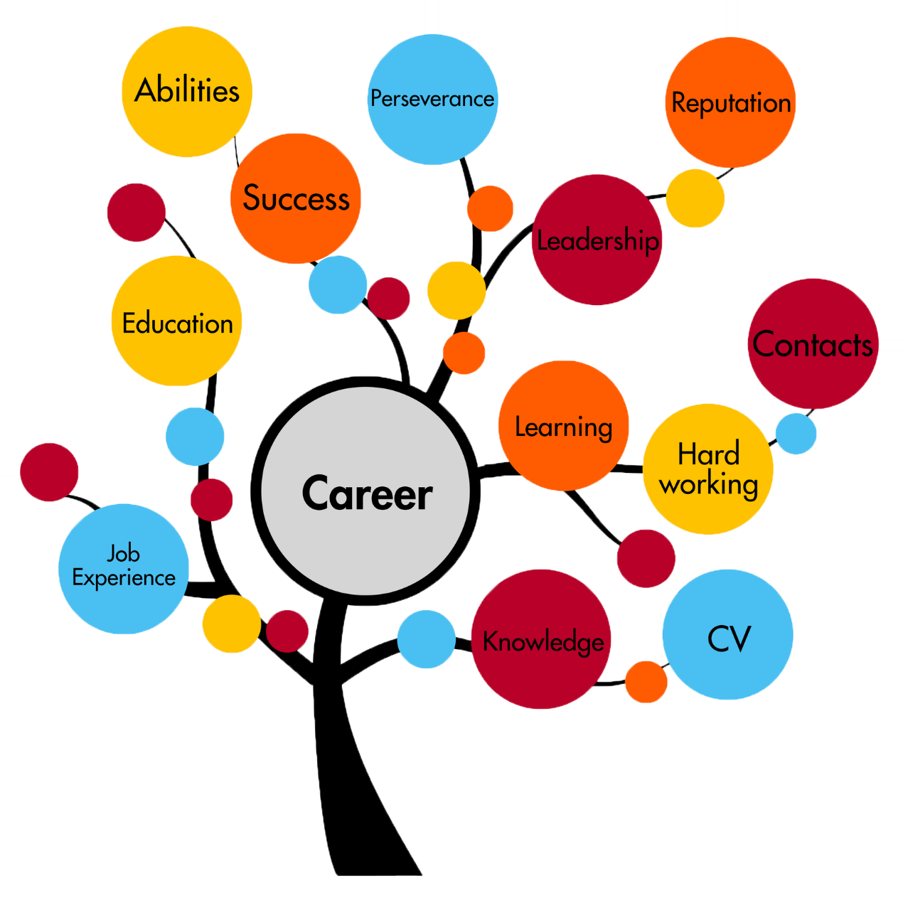
Career Guidance for Intermediate and Secondary Education in Pakistan
Presented by:
Unab Zahra(Bscs13045)
Usman Sarwar(Bscs13047)
Ali Aslam(Bscs13072)

Slide 2

Motivation
Why most of the students are not getting the degree of their interest?
Why there is a rise in unemployment rate in Pakistan?
Why most of the students aim to become either an “engineer” or a “Doctor”?

Slide 3

Introduction
Education guidance is a procedure to help students to get to know what options are best for them
Counseling and formal guidance help students to make right career decisions and make their life easier with institutes, curriculum, and jobs

Slide 4

Objective
To provide proper education guidance system through which students can visualize “What are the oppurtunities for them to choose their path for a bright future”

Slide 5
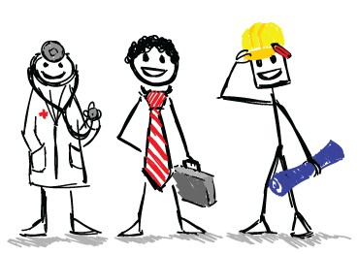
Product
We aim to make a web-based platform to help students to make effective decisions regarding their studies.

Slide 6
Approach

Slide 7
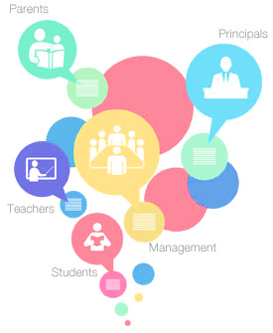
Stack Holders Identification
Students (Primary)
Parents (Primary)
Teachers (Secondary )
Education Consultants (Secondary)

Slide 8
Sample
Survey was conducted in areas of Lahore.
For the selection of sample, we designed a spectrum so that we can cover all categories of individuals including rich, poor and mediocre.
Our selection spectrum was based on the use of technology by an invdividual and education qualification of an individual.
We tried our best to pick the representative sample for the survey.
Our sample comprises of total 6 interviewees ( 3 students, 3 parents)

Slide 9

Primary Data
Survey conducted among the primary stakeholders.
Our survey was mainly quantitative as it included close ended questions

Slide 10

Questions asked were:
From students:
What do u want to become in future?
Do you know any institute who can consult you in studies?
Will you be fine if some one consults you for furthur studies?
From Teachers:
If some portal is made to consult your child then will you use it?
Is there anyone to consult you or your child for his furthur studies?
How will you decide which field is good for your child?

Slide 11

Results (by survey)
By surveying different students and parents, we came to know that our project is more suitable for middle class families and those families who are less educated.
Since less educated parents cannot guide their children in selecting their field, this platform will be very beneficial for them
Many parents think that students should be given an opportunity to choose the field of study of their choice and interest
Most of the students said that they face difficulty in selecting an appropriate institute so they think there should be some online platform which can guide students in choosing the subject and a suitable institute

Slide 12
Results (continued…)
When we surveyed the class of poor people, most of them said that they have not thought of any specific future aim because they do not have any well-educated person in the family who could guide them properly.
One of the parents, discouraged the idea of web portal because they said that parents have no time to access online information and search for the guidance on the internet portal due to the lack of interest. Moreover, they do not trust the information available on the web
On the other hand, educated parents help their children in selecting the subjects and institutes because they want their children to become a successful person irrespective of their child’s interest

Slide 13
Empathy map
Say
Most said “This seems to be interesting idea and they will be waiting for the idea to be implemented”.
One of the criticisms we faced, “Many surveys were conducted before but no one is ready to implement the idea”, so they are not even willing to answer our questions
DO
Most of the interviewee, are relaxing at home, as we have chosen time one which, parents and children both at home.
Secondly, it helps us, in a way that they are willing to answer our questions.

Slide 14
Empathy map (continued…)
Think
We think, this idea will be loved among the general public.
As the most important, point we have noticed during the survey is the lack of awareness among the students and parents.
Most of the students are confused, that what they will be doing in near future
While most of the parent were unable to guide their children for their future plans.

Slide 15
Empathy map (Continued…)
Feel
Most of the interviewees seems to be quite calm and were very cooperative during the surveys. But for one interviewee, it took time to be comfortably talking to him

Slide 16
Summary
We reached on the conclusion that children and parents were interested to know about our project.
They were eager to know that there will be some online help and they will not have to go to some consultant for education.
It will be helpful for parents to decide that which field they should select for further studies.

Slide 17
Thank You!

